Slide 1
Provider Overview
Care Choice Tool - The Free Choice of Provider Solution

Slide 2
Logging In
You will always login with your email address.
If you forget your password, click the link to reset.

Slide 3
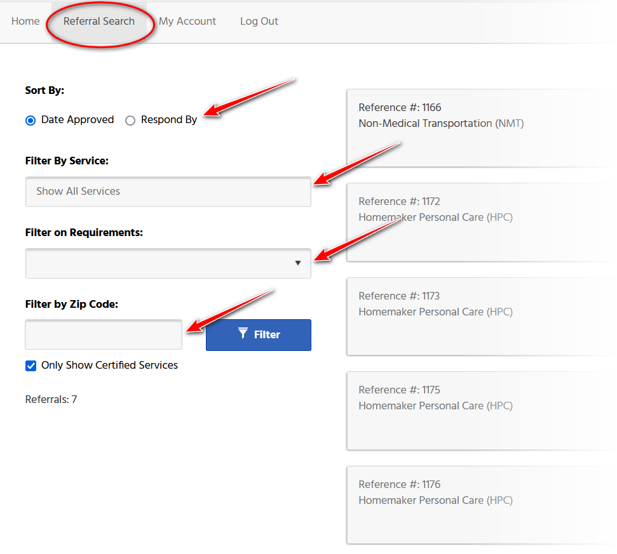
Viewing Referrals
Click on Referral Search in the top menu.
The referrals will display with an option to filter by:
Service
Requirements
Zip Code
You can also Sort by:
Date Approved
Respond by Date

Slide 4
Color Coding
Immediate Attention
Referrals shaded RED indicate that services are needed immediately to address a health/safety risk.
Please review/respond as soon as possible.
Non-Certified Services
Referrals shaded AMBER indicate that the provider is not marked as certified for this referral.

Slide 5
Icons
The icon indicates special communication needs.
The wheelchair icon indicates that the person seeking services has accessibility requirements.
The bus icon indicates the person will need a modified vehicle.
The graduation cap indicates that the person is a transition student – currently in high school and planning to graduate within the next year.
The house icon indicates the person is looking for a new living arrangement.
The paperclip icon indicates the referral has a file attachment
Referrals can have one or more icons to highlight special conditions.

Slide 6
Items to Note
Referrals are posted on the website with the NEWEST referrals on top.
Each referral is for a single service type.
To open a referral, simply click anywhere on the referral panel.

Slide 7
The Referral
The referral will open and replace the search screen.
Referrals will look different and have different fields showing based on the service type of the referral.
If interested in providing services, click on the I’m Interested button.

Slide 8
Response Form
Enter the date you can provide services.
The comment section is the BEST PLACE to provide specific information that will be shared with the individual about YOU and the services you can provide.
Click on Respond to Request to complete the form.

Slide 9
Responses to Referrals
The person will decide which provider(s) they want to interview.
Providers will be contacts by the SSA directly.
If you were not selected to provide services, you will still be contacted by the Care Choice Tool.

Slide 10
My Account
Allows you to change:
First name
Last name
Contact number
Password

Slide 11
Let’s Get Started
We’ve been a trusted partner in web design since 1997.
See what our team can do for you!
 | phone: 330-707-0432 | 877-367-4364

